Slide 1

E
xample
Let's take this magic to WMS

Slide 2
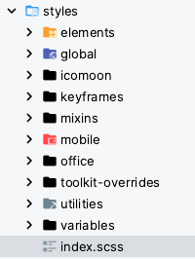
E
xample
03/03/2023
You see what I did here?
(Settings)
30/08/2023
16/10/2023
(Settings)
03/03/2023

Slide 3
E
xample
Let's be critical

Slide 4
E
xample 2
global?

Slide 5
E
xample 2
Everything is "global"

Slide 6
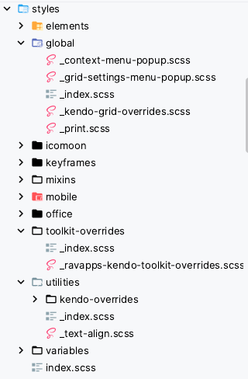
E
xample 3
overrides ?

Slide 7
E
xample 3
Everything is "overrides"

Slide 8
E
xample 4
I want to write CSS that will override all kendo-grid borders... And it's not in ravapps-kendo-toolkit yet…
Where do I put it?

Slide 9
E
xample 4
OK, fine. And it works like a charm…

Slide 10
E
xample 4
OK, fine. And it works like a charm…
Now I also override the color of the grid header, and I've put it here since it's also a part of kendo-grid…
But it doesn't work!

Slide 11
E
xample 4
OK, fine. And it works like a charm…
Now I also override the color of the grid header, and I've put it here since it's also a part of kendo-grid…
But it doesn't work!

Slide 12
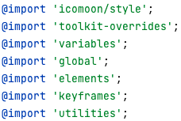
E
xample 4
It seems it's also overriden in ravaps_kendo_toolkit…
And looking at the main barrel file,
it makes sense:

Slide 13
E
xample 4
Conclusion: WTF?

Slide 14
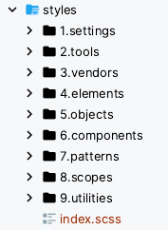
F
inal: Let's rearrange

Slide 15
F
inal result

Slide 16
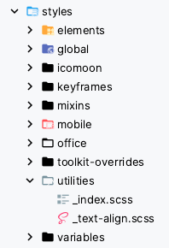
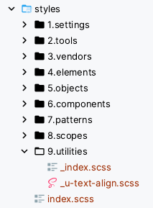
F
inal result

